Slide 1
Voting Machine
CS-226 Mini Project
Name :- Dolesh Roll No. :- 1901CS20

Slide 2
Things used :-
1) Arduino Uno R3 microcontroller 2) LCD 1602 module 3) Buttons 4) Potentiometer 5) Jumper wires 6) Breadboard

Slide 3
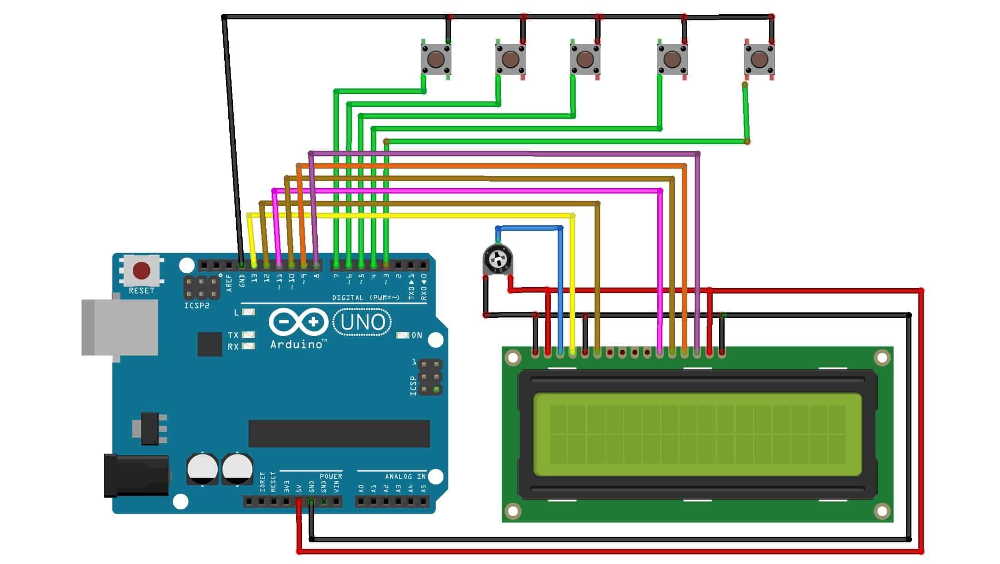
Circuit Diagram : -

Slide 4
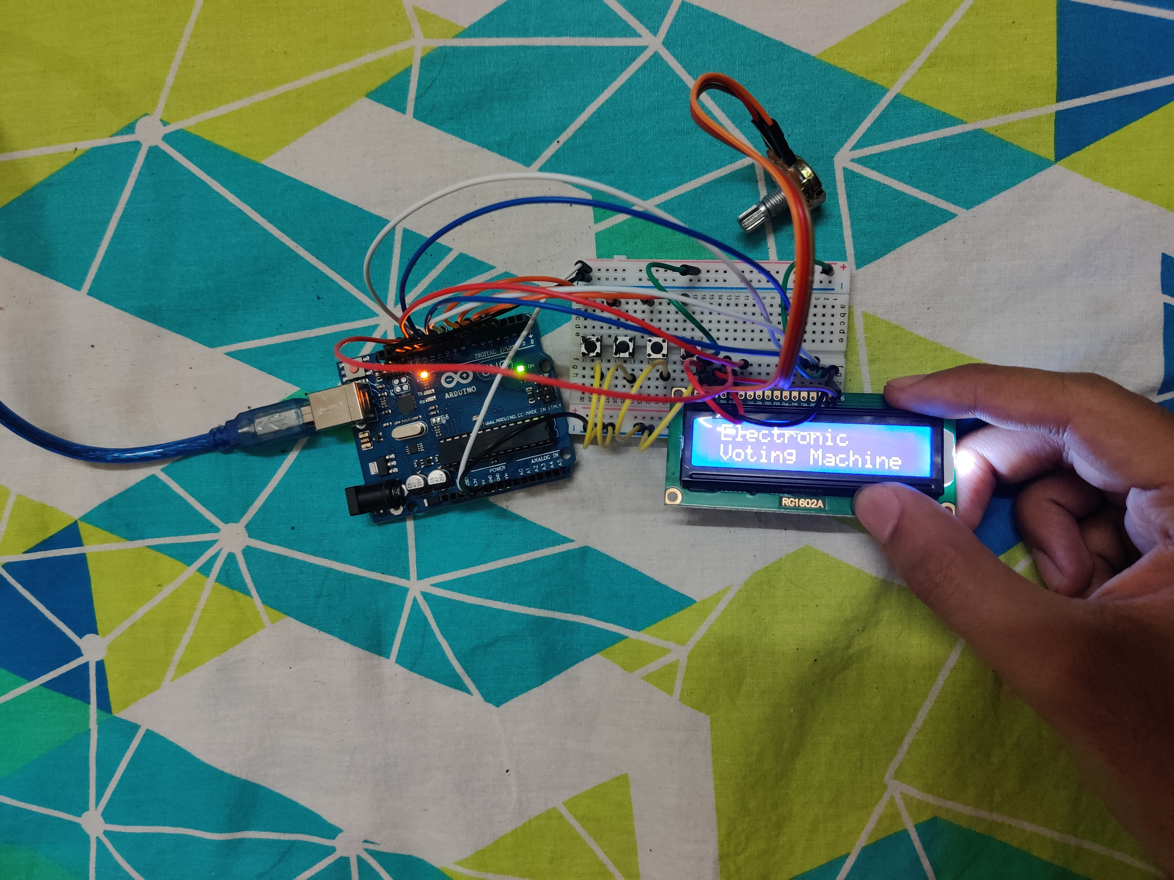
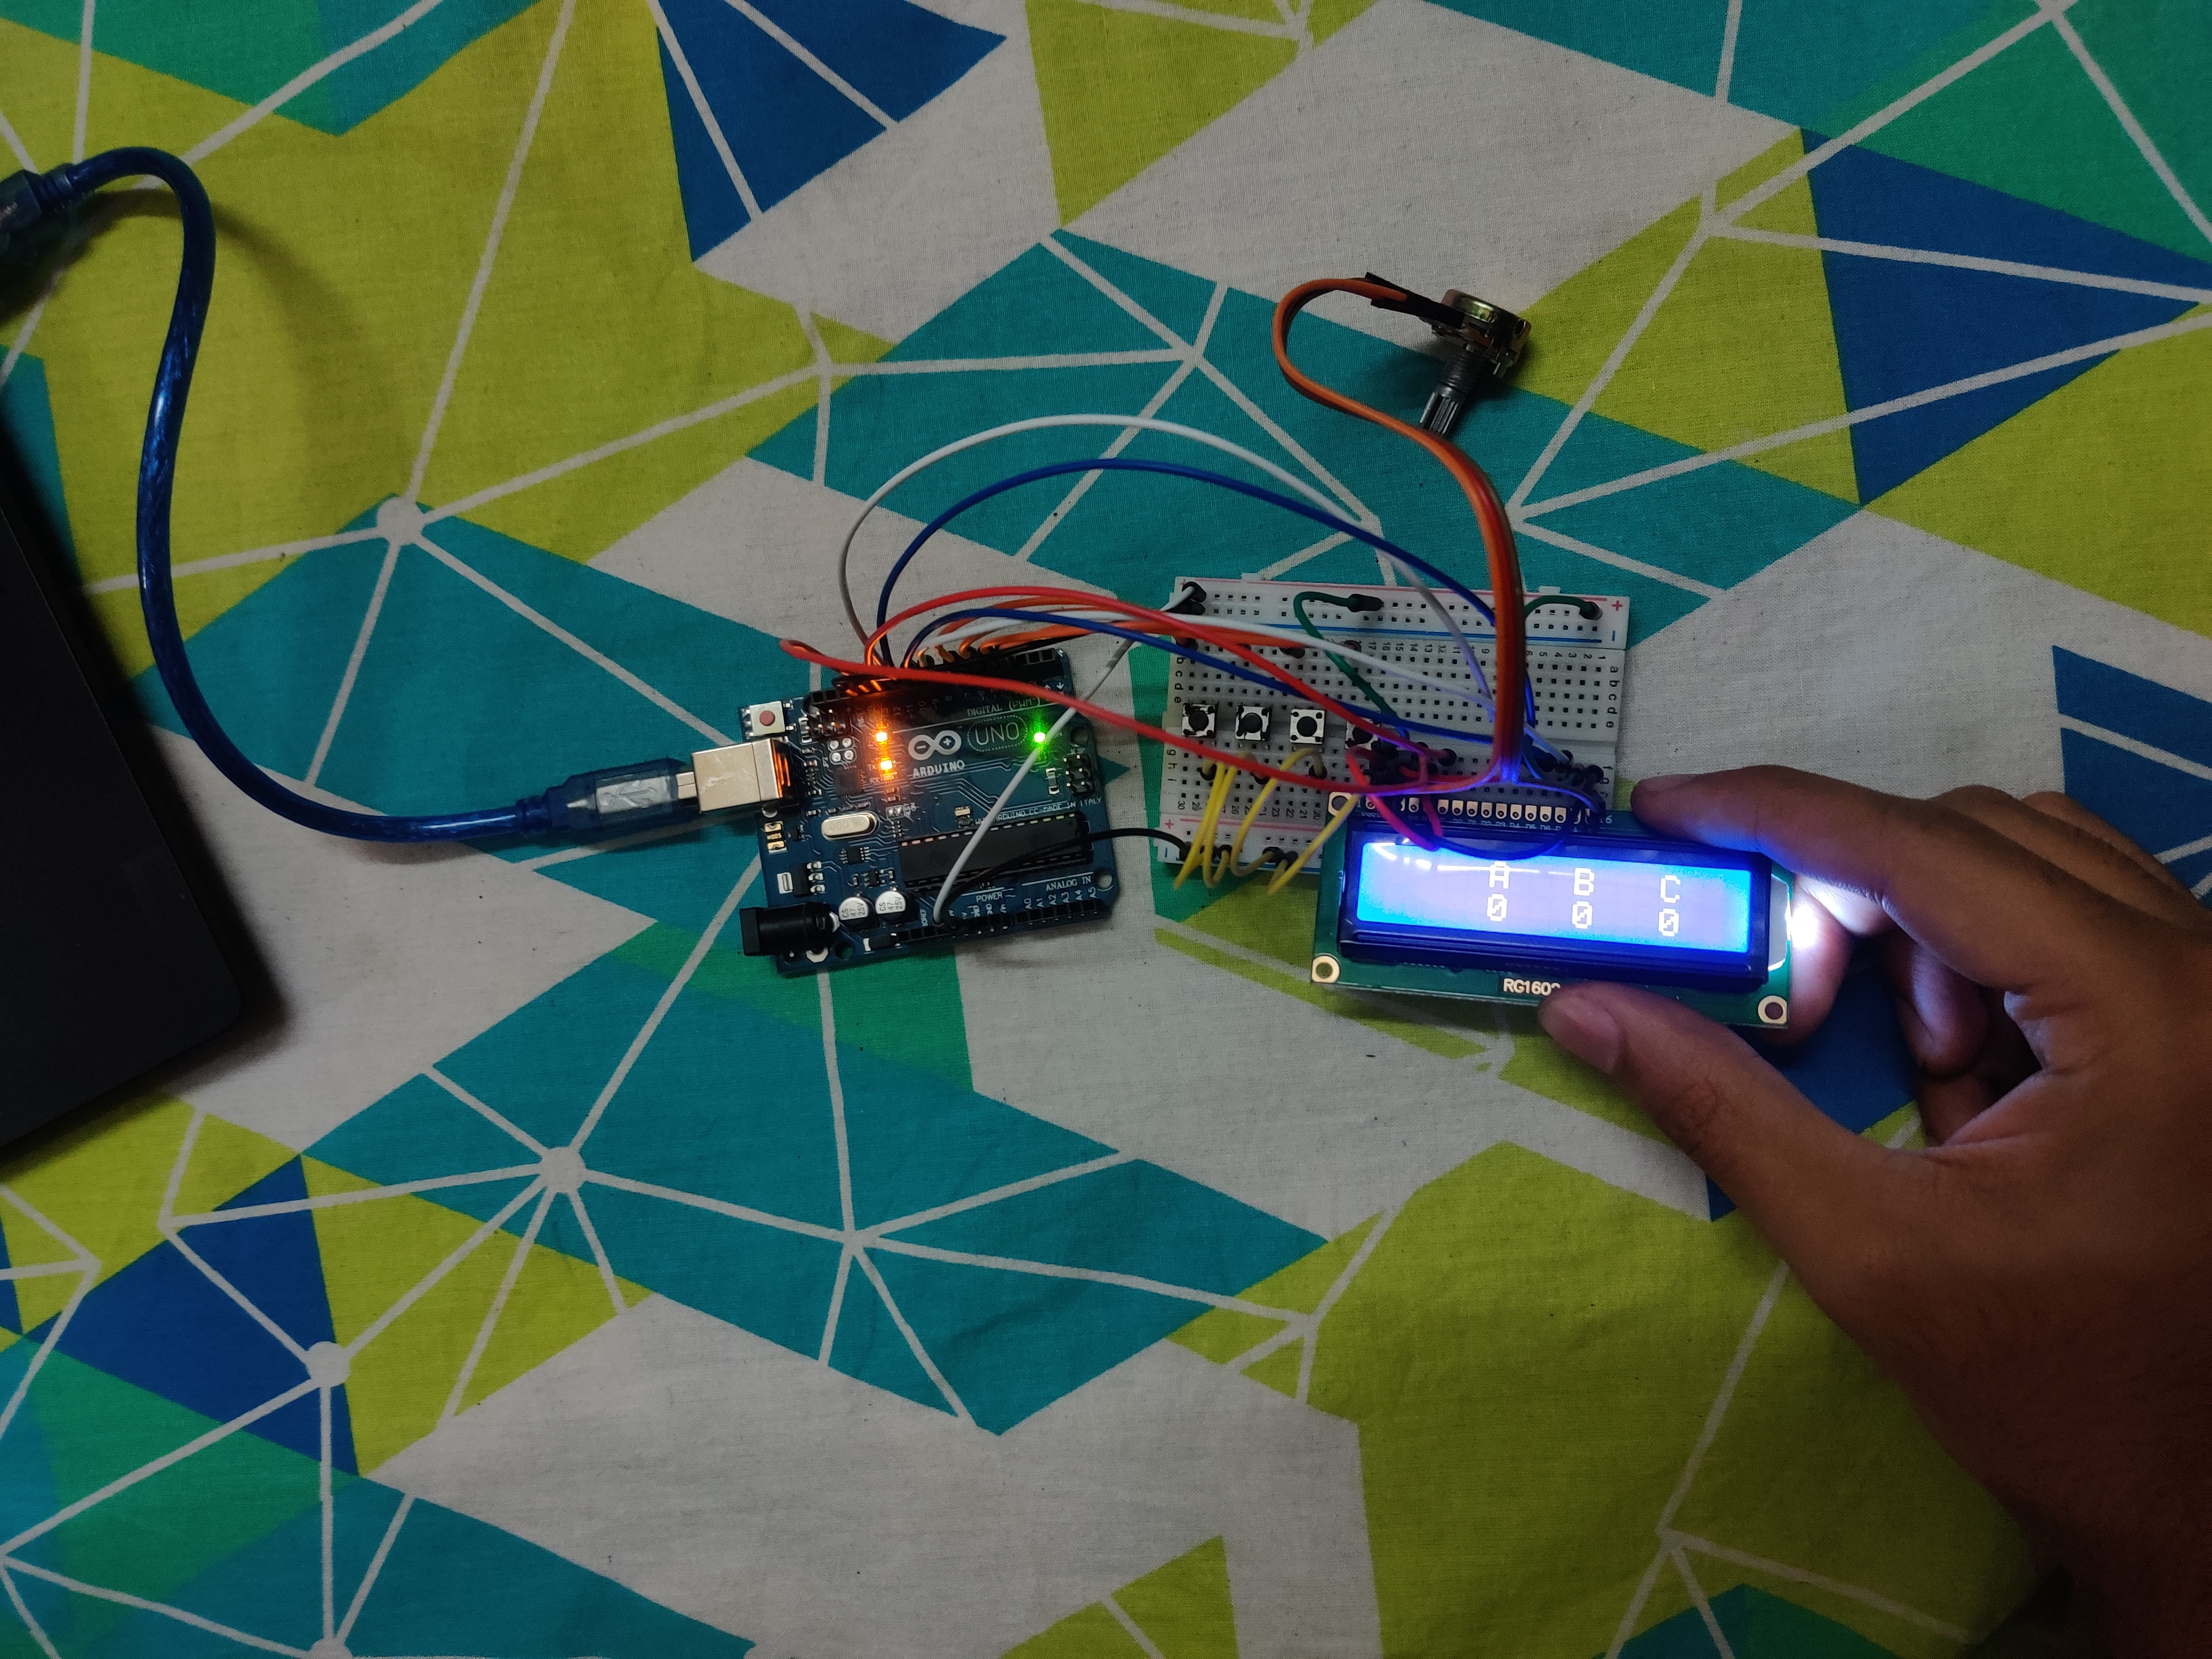

Slide 5
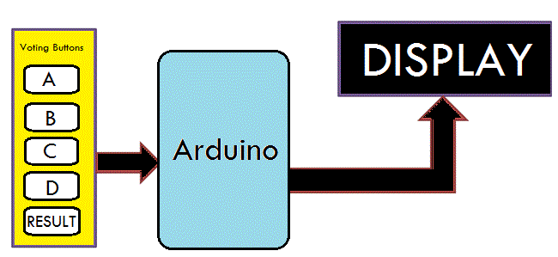
This is the block diagram of the project. In this ,we have buttons for candidates and one button to show the result. The number of participants can be increased as per the needs.
When any voter press any of the buttons then respecting voting value will increment by one each time. After the whole voting process, the result button can be pressed to display the result.

Slide 6
Working of the Project
Circuit of this project is quite easy which contains Arduino, push buttons and LCD. Arduino controls the complete processes like reading button, incrementing vote value, generating result and sending vote and result to LCD. The code is written in Arduino IDE and checks the result using if else conditions.

Slide 7
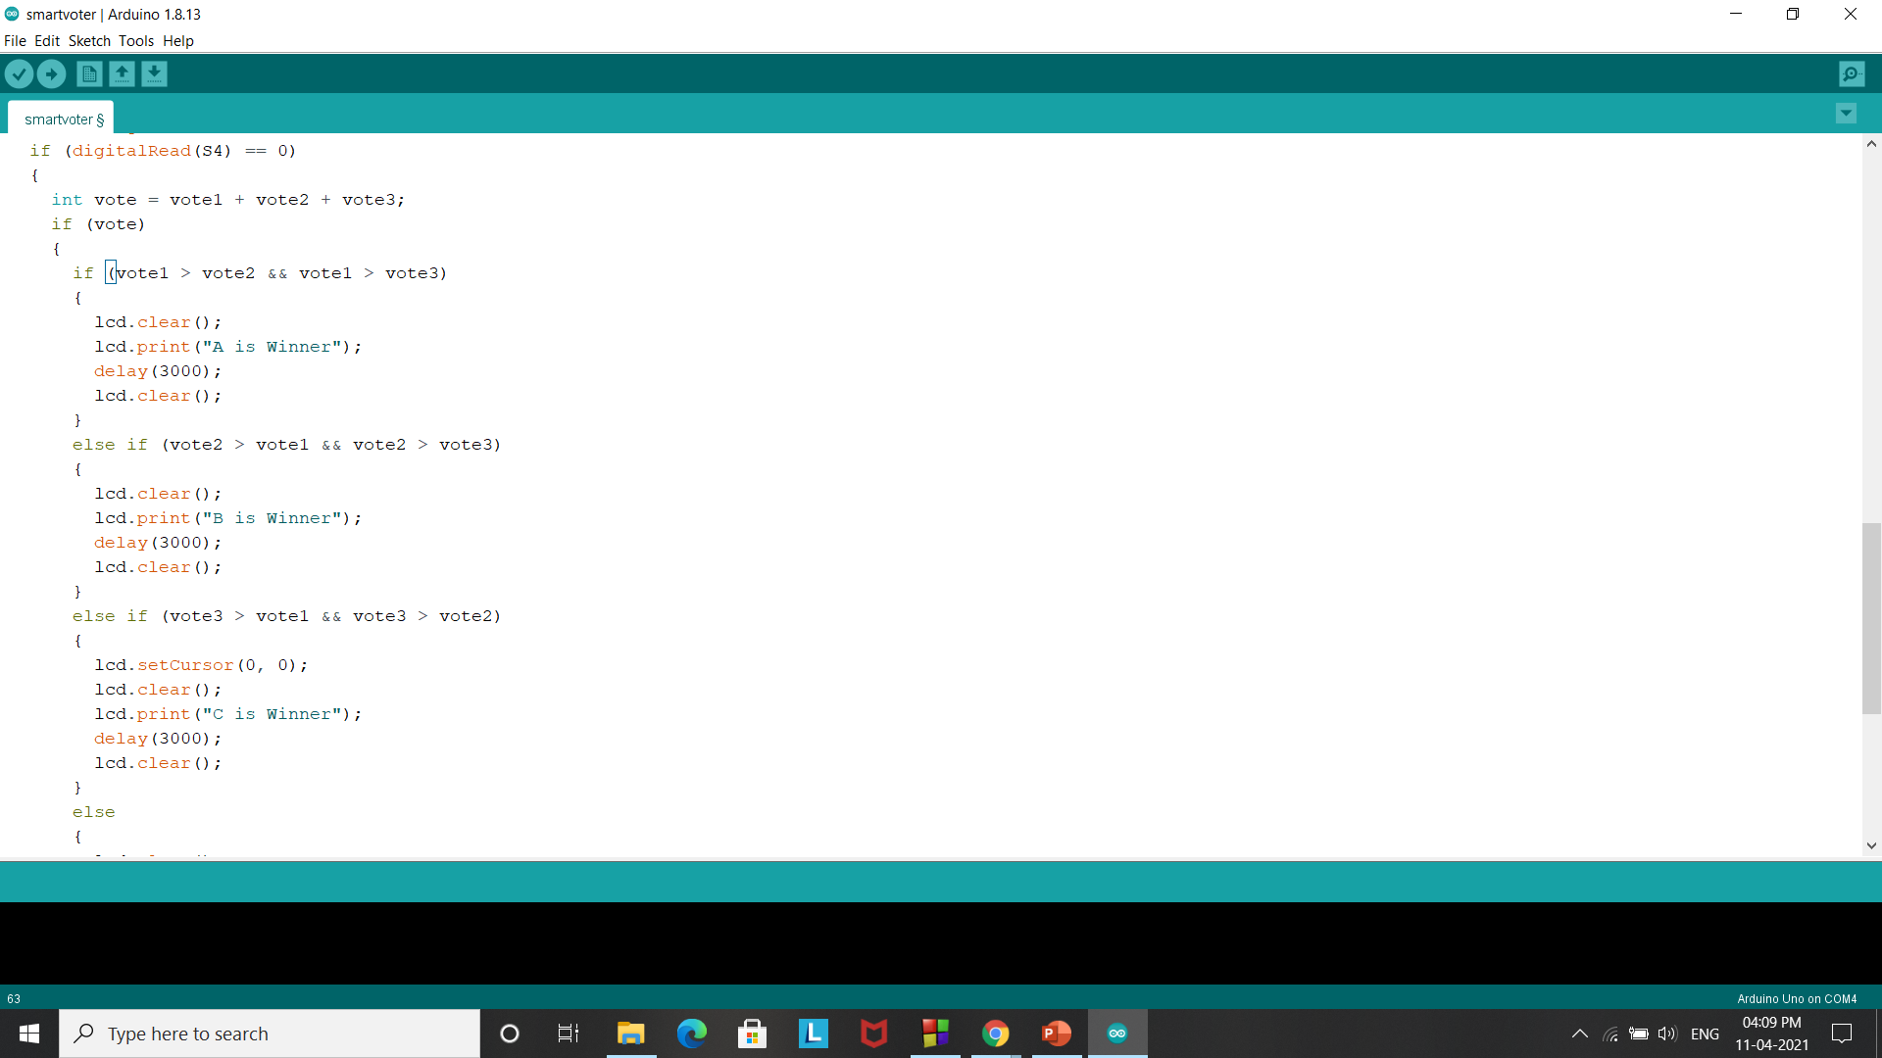
Code to find winner

Slide 8
Applications
It can be used with fingerprint scanner or optical sensors for biometric verifications.
Eradicate defrauding of the manual voting systems. Also being portable , it is easy to carry.
Other applications includes - automated train ticket system, automated bus ticket system, unauthorized vehicle detection system, traffic signal breaking detection system.

Slide 9
It was a nice learning experience working on this project.
Thank You!

